Slide 1
Asynchronism in action with rxJava

Slide 2
History
Blocking synchronous approach
Callbacks
Promises
Reactive Extensions
Async/Await

Slide 3
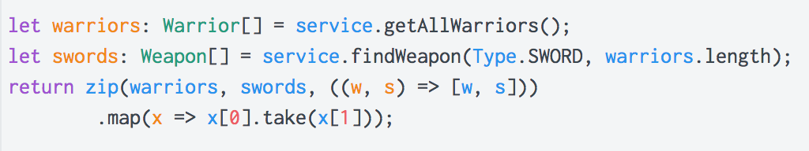
Blocking synchronous approach
Each operation must be accomplished before the next one can start
Every operation is executed in the main thread
Every operation can last as long as it’s necessary
Code can become more and more complex when we need to deal with error handling, logging, etc

Slide 4
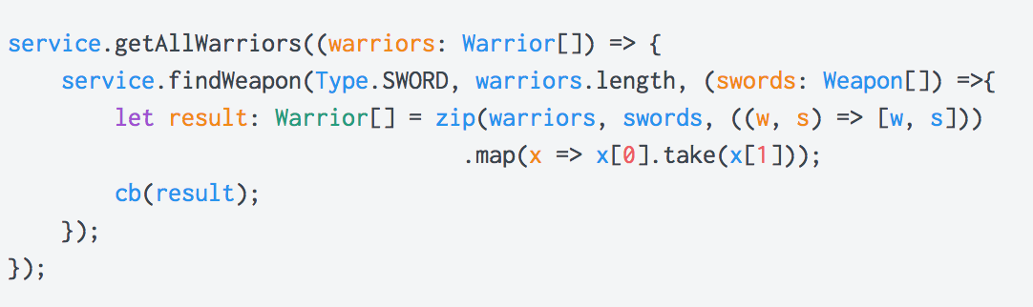
Callbacks
Each callback is called when previous one finished its work
Every operation is executed in the main thread
Code becomes very complex in short amount of time
Possibility to get into callbacks Hell

Slide 5
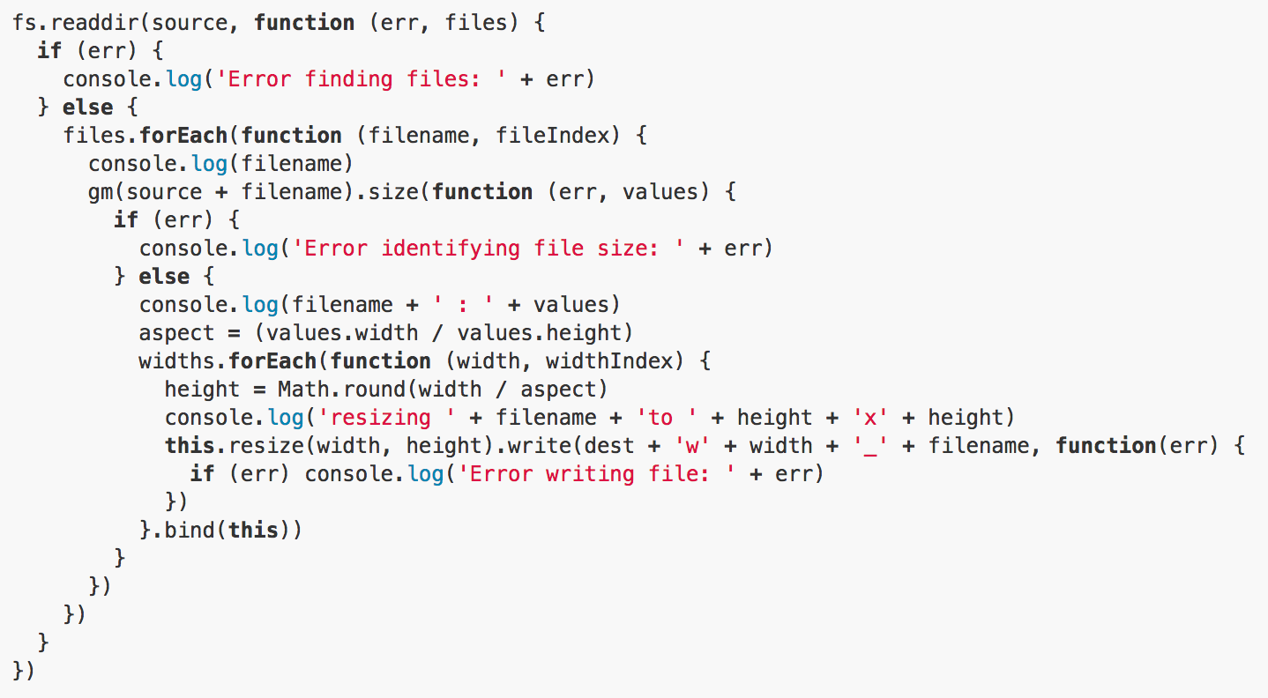
Callbacks Hell

Slide 6
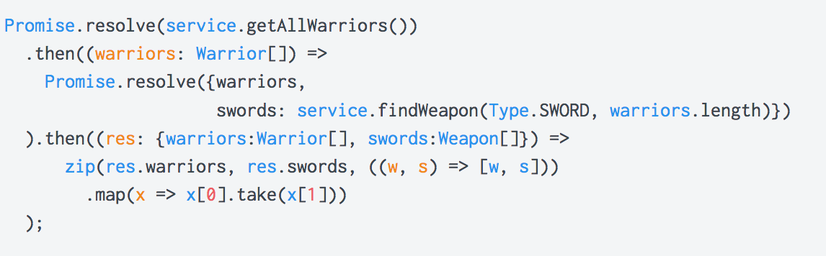
Promises
Upper method receive a promise object
Promises can be combined with ease
Error handling is easy
Everything is run in main thread

Slide 7
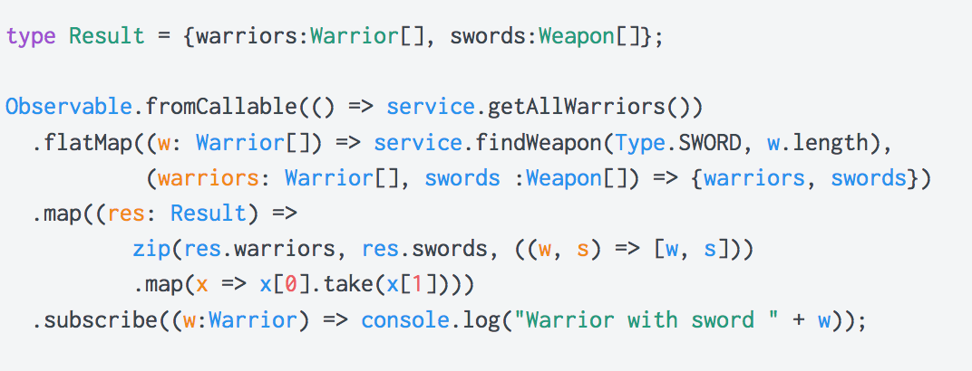
Reactive extensions
Upper method can receive an observable object
Observable can be combined with ease
Error handling is easy
Everything is run in main thread, but it’s up to you to configure it in parallel way

Slide 8
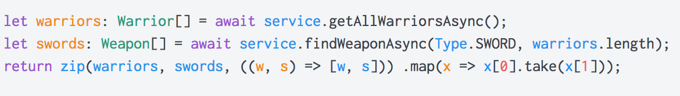
Async/Await
Kind of syntactic sugar, does not exist for java
Requires to specify the upper method as async and it must return a Task of T
Error handling is easy
Everything is run in main thread

Slide 9
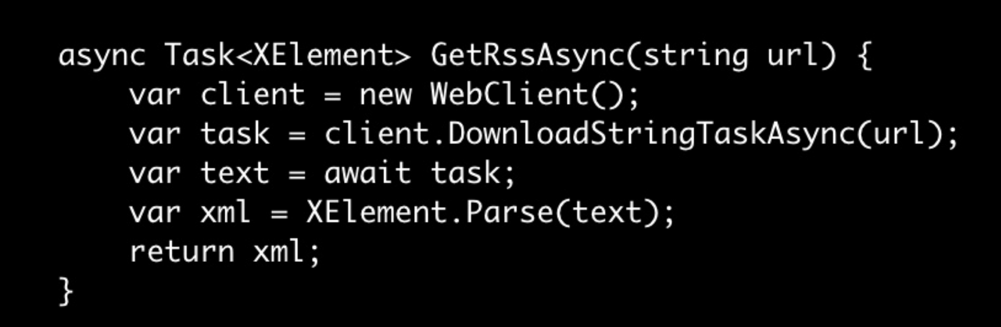
Async/Await magic
Before the compilation

Slide 10
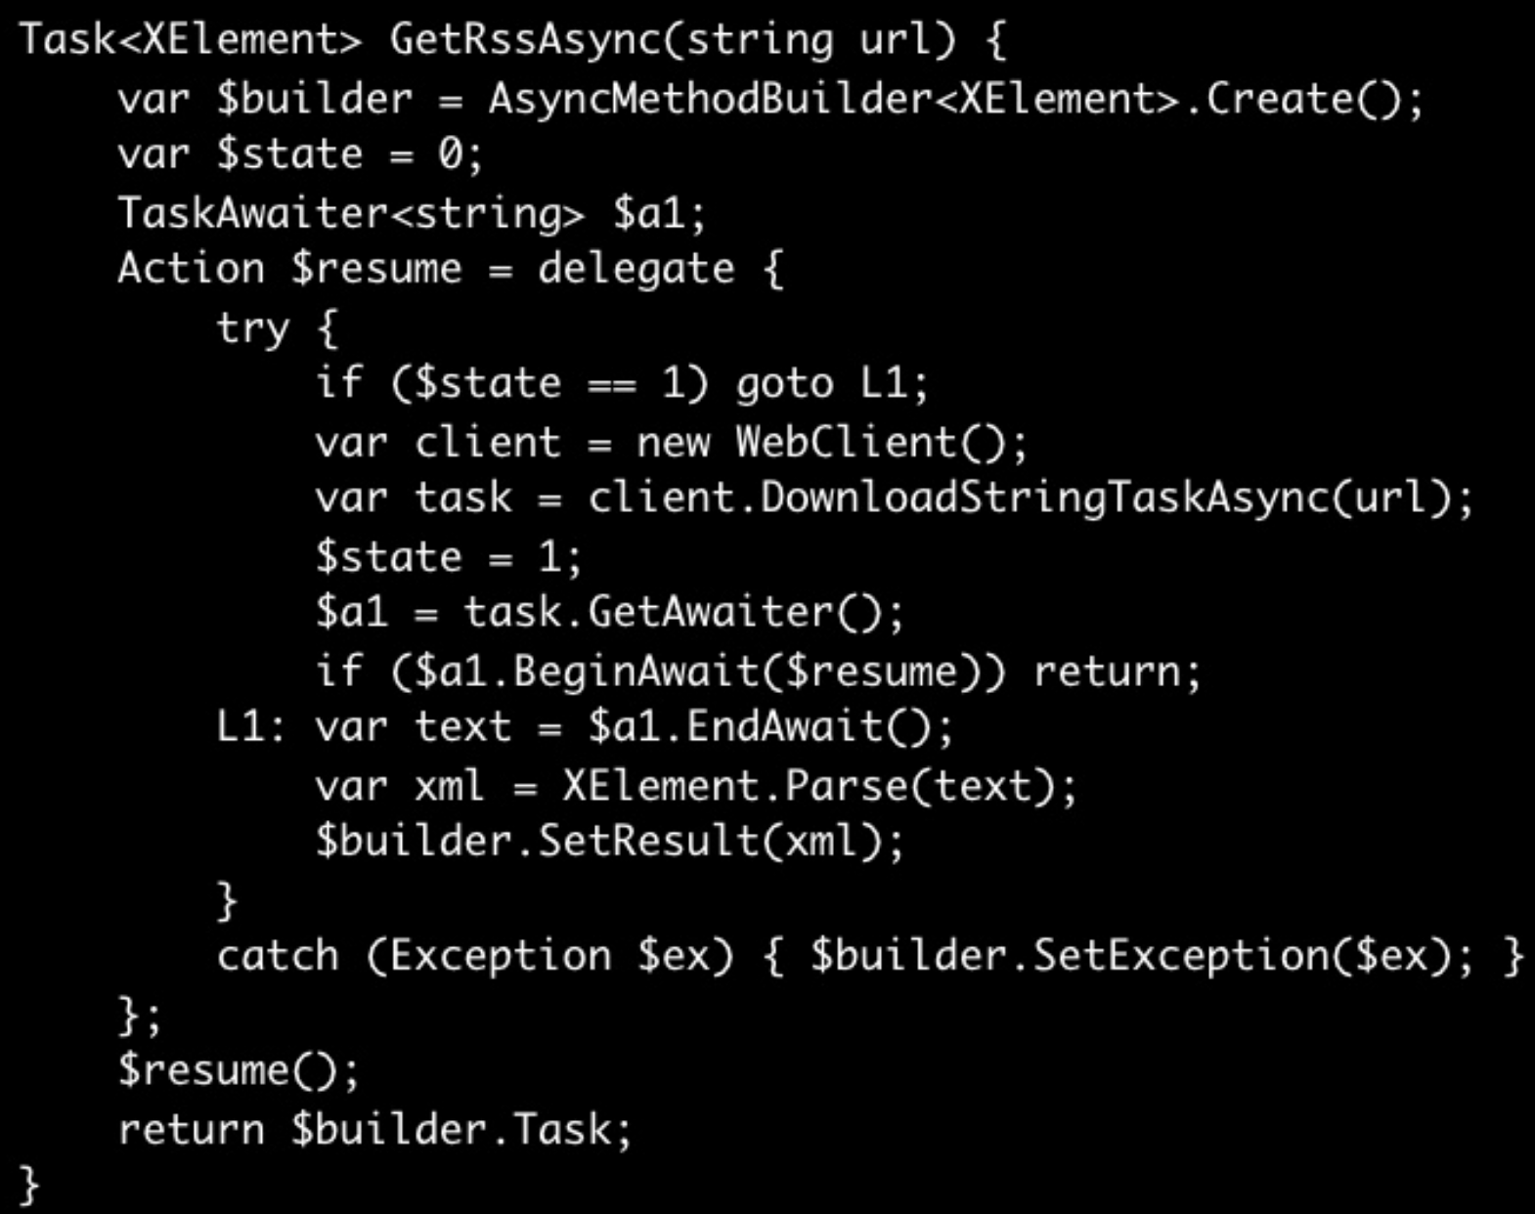
Async/Await magic
After the compilation

Slide 11
Async/Await facts
Async methods are intended to be non-blocking operations. An await expression in an async method doesn’t block the current thread while the awaited task is running. Instead, the expression signs up the rest of the method as a continuation and returns control to the caller of the async method.
The async and await keywords don't cause additional threads to be created. Async methods don't require multithreading because an async method doesn't run on its own thread.
The marked async method can use await to designate suspension points. The await operator tells the compiler that the async method can't continue past that point until the awaited asynchronous process is complete. In the meantime, control returns to the caller of the async method.

Slide 12
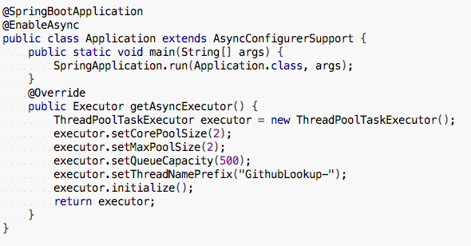
Async with Spring
Step 1

Slide 13
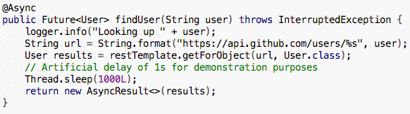

Async with Spring
Step 2

Slide 14
Reactive extensions exercises
Let’s grok Reactive Extensions

